Slide 1
CLIPS
Flowers Expert System
CSE 386: Artificial Intelligence Course Project
Faculty of Engineering, Ain Shams University

Slide 2
Contributors
Aly Mohamed 15P5072
Mostafa Hazem 15P6017
Mohamed El Ghamry 15P6019
Mohamed Hussein 15P6026
Yasmin Ibrahim 15P60

Slide 3
Agenda
1
Overview
3
Demo
2
CLIPS Printout
4
References

Slide 4

Overview
Simple GUI based Expert System that asks you a couple of questions about a certain flower, and answers with its name as a result depending on a some facts and rules predefined in its knowledge base.
Technologies Used
Java programming language.
Clips tool for Building Expert Systems

Slide 5


CLIPS Printout
The CLIPS Printout file that exists in the repo directory is a clips file with .clp extension that contains all the rules, facts, etc. needed for the application knowledge base.
Implementation:
CLIPS printout file preview on vscode or clips ide

Slide 6
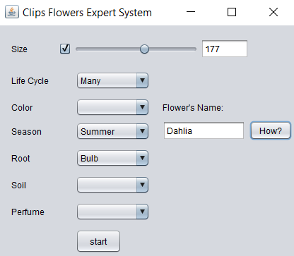
DEMO

Slide 7
References
Github Repo - https://github.com/mostafa172/FlowersCLIPS
CLIPS - http://www.clipsrules.net
CLIPSJNI - https://sourceforge.net/projects/clipsrules/files/CLIPS/6.40_Beta_2
Java - https://docs.oracle.com/javase/7/docs/api

Slide 8
Thank you.

